Slide 1
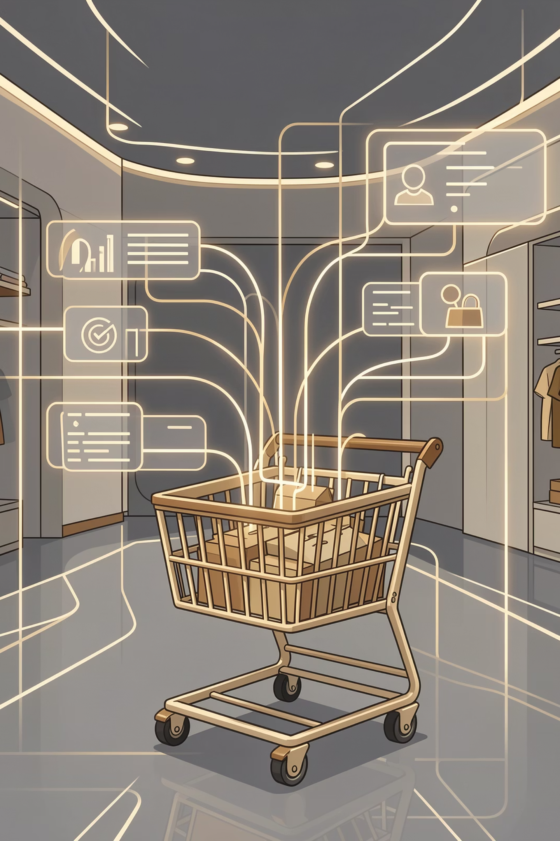
Customer Shopping Behavior Analysis
Uncovering insights from transactional data to guide strategic business decisions.

Slide 2
Project Overview & Dataset Summary
Project Goal
Key Features
Analyze 3,900 purchases to understand spending, segments, preferences, and subscriptions.
Customer demographics (Age, Gender, Location, Subscription)
Purchase details (Item, Category, Amount, Season, Size, Color)
Shopping behavior (Discount, Promo, Previous Purchases, Frequency, Review, Shipping)
Dataset Size
3,900 rows, 18 columns.
Missing Data: 37 values in Review Rating.

Slide 3
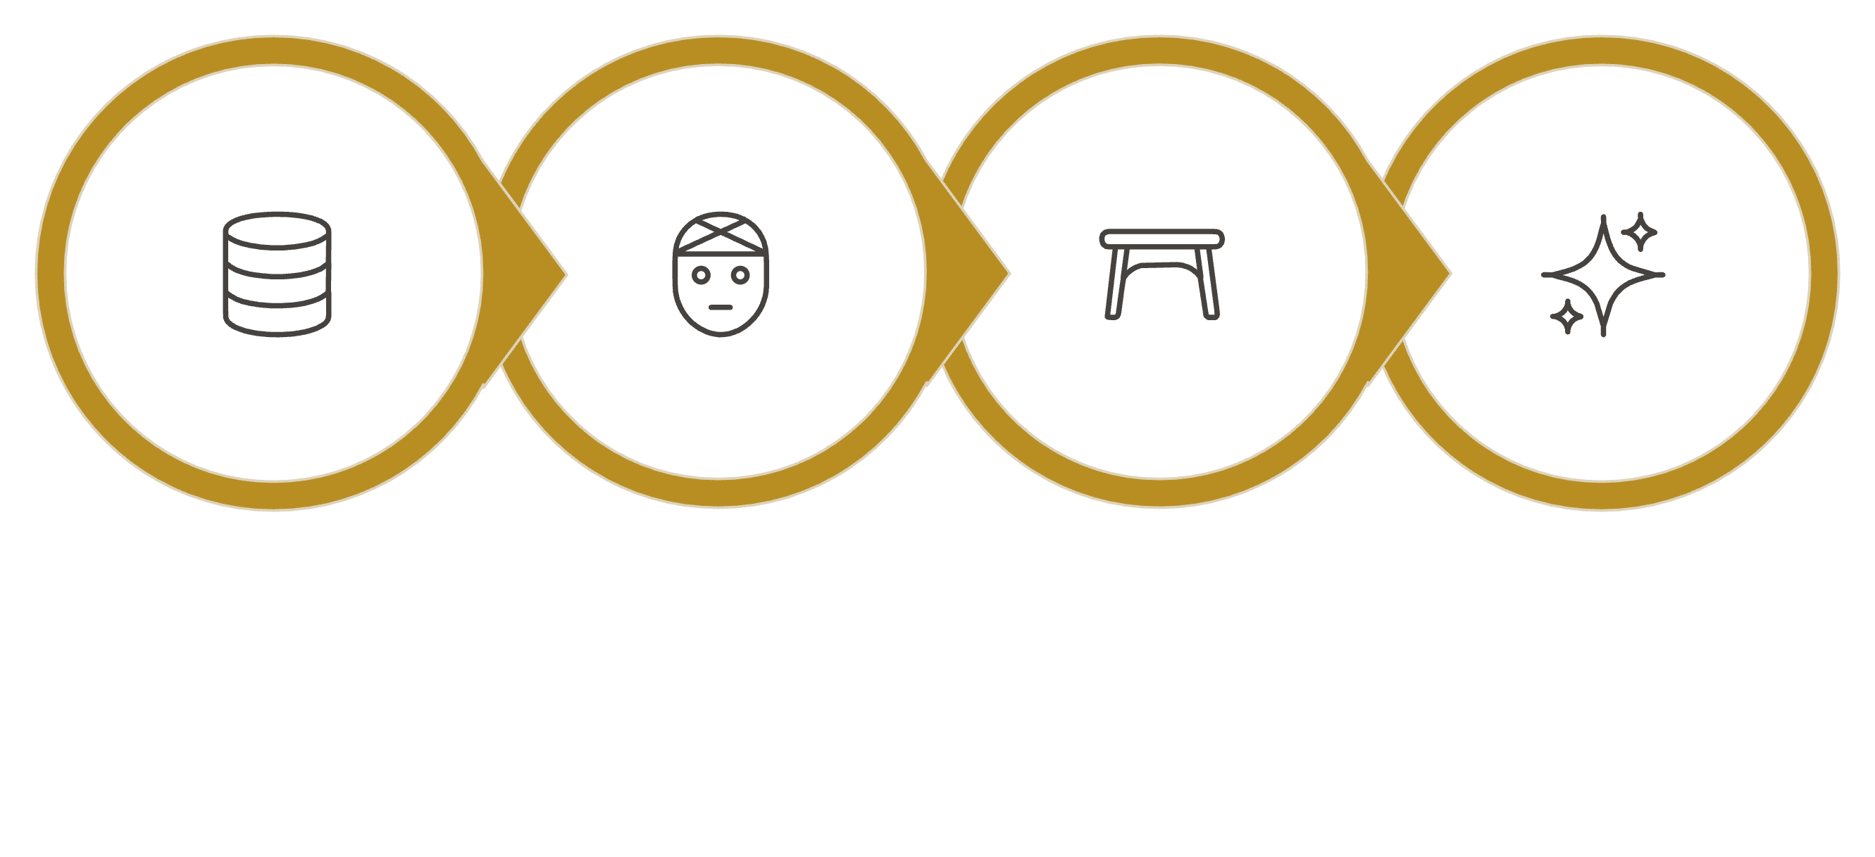

Exploratory Data Analysis: Python
Column Standardization
Data Loading
Missing Data
Feature Engineering
Our Python-based EDA focused on cleaning and enhancing the dataset for deeper analysis.

Slide 4
Data Analysis: SQL Insights
Revenue by Gender
High-Spending Discount Users
Male customers generated significantly more revenue.
Identified 839 customers who used discounts but spent above average.
Top 5 Products by Rating
Shipping Type Comparison
Gloves, Sandals, Boots, Hat, Skirt received highest average ratings.
Express shipping users had slightly higher average purchase amounts.

Slide 5
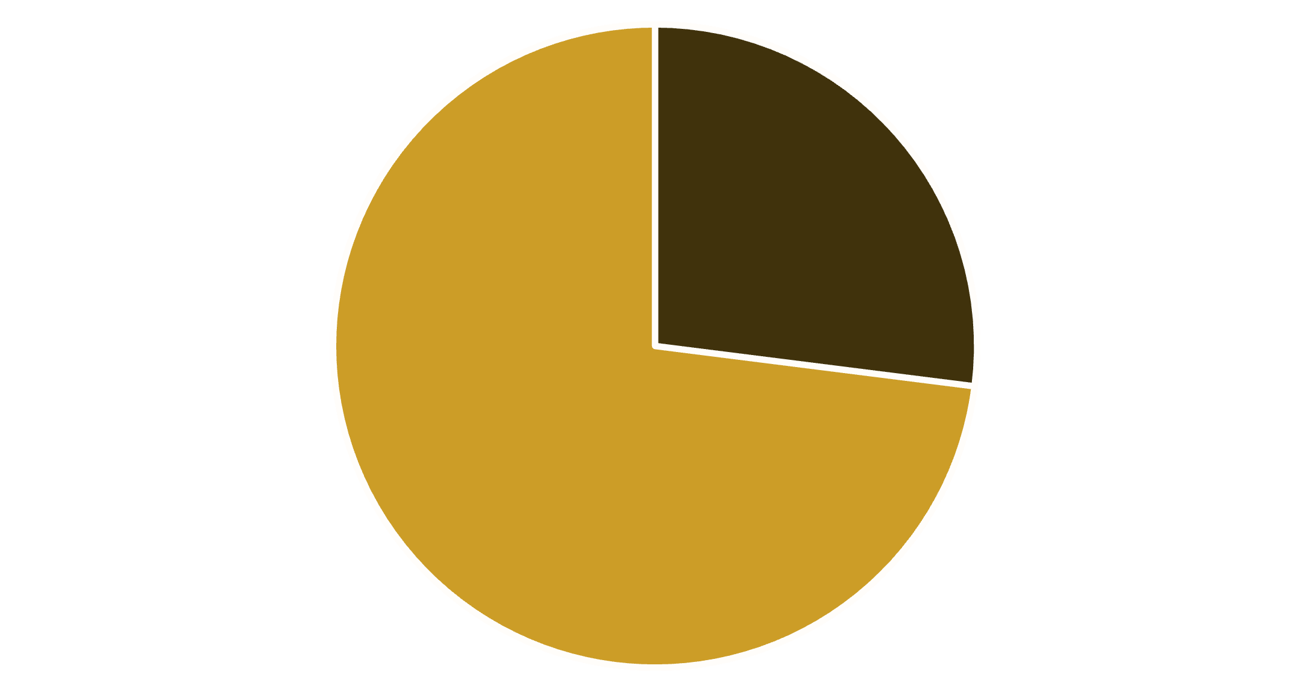
Subscription & Discount Analysis
Subscribers vs. Non-Subscribers
Discount-Dependent Products
Top 5 products with highest percentage of discounted purchases:
Hat (50%)
Sneakers (49.66%)
Coat (49.07%)
Sweater (48.17%)
Pants (47.37%)
Yes
No

Slide 6
Customer Segmentation
Loyal
New
Returning
3116 Customers
83 Customers
701 Customers
Segmentation based on purchase history reveals a strong loyal customer base.

Slide 7
Top Products by Category
Accessories
Jewelry
1
171
Accessories
Sunglasses
2
161
Clothing
Blouse
1
171
Clothing
Pants
2
171
Footwear
Sandals
1
160
Footwear
Shoes
2
150
Most purchased items within key product categories.

Slide 8
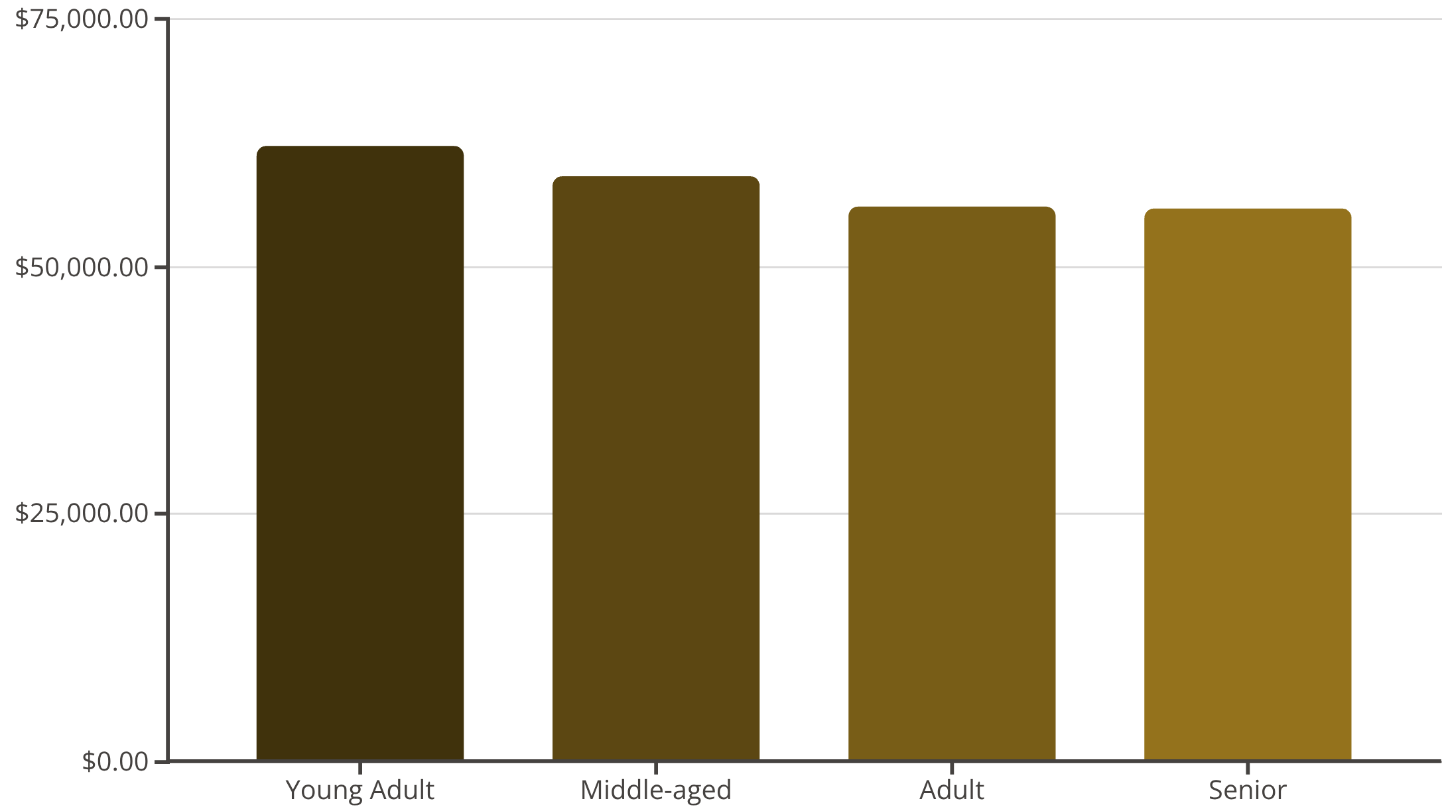
Revenue by Age Group
Young adults contribute the highest revenue, followed closely by middle-aged customers.
Repeat Buyers & Subscriptions
Customers with >5 purchases are more likely to subscribe.
Non-subscribers: 2518
Subscribers: 958

Slide 9

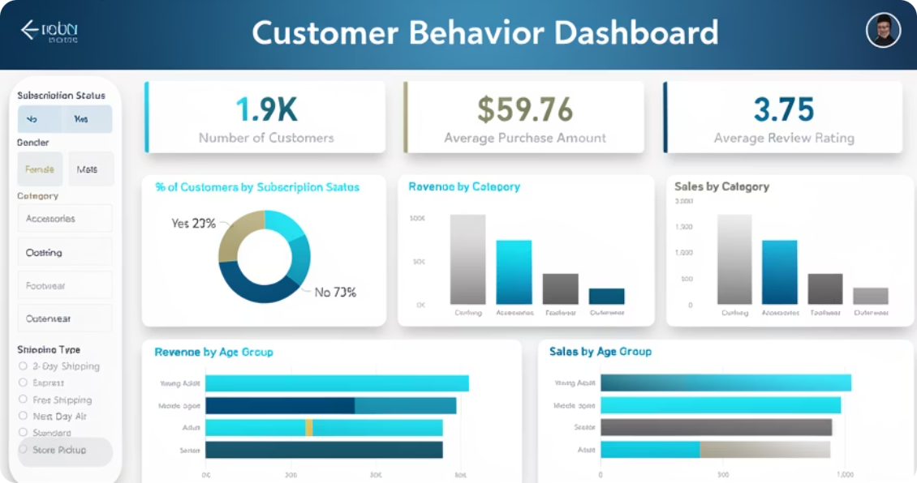
Interactive Dashboard in Power BI
Visualizing key metrics: customer count, average purchase, review ratings, and revenue/sales by category and age group.

Slide 10
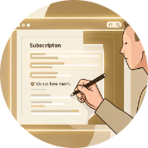



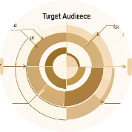
Business Recommendations
Boost Subscriptions
Customer Loyalty Programs
Review Discount Policy
Product Positioning
Promote exclusive benefits to increase subscriber base.
Highlight top-rated and best-selling products in marketing campaigns.
Reward repeat buyers to foster loyalty and move them to the "Loyal" segment.
Balance sales boosts with careful margin control.
Targeted Marketing
Focus efforts on high-revenue age groups and express-shipping users.

